Slide 1
Python Programing : TOPIC: Personal To-Do List Application
NAME: Prajwal L G (information collection about project)
Panushree (Ppt presentation slides)

Slide 2
Introduction: Brief Overview of the Application
Personal To-Do List Application! This application is designed to help users efficiently manage their daily tasks and stay organized. Whether you’re a student, professional
Key Objectives:
Task Management: Easily add, edit, and delete tasks.
Prioritization: Assign priority levels and due dates to ensure important tasks are completed on time.
Categorization: Organize tasks into different categories or projects for better clarity.

Slide 3
Application Features
Task Management
Add Tasks: Easily add new tasks with a title, description, due date, and priority level.
Edit Tasks: Modify existing tasks to update details or change priorities.
Delete Tasks: Remove tasks that are no longer needed.
Categorization
Organize Tasks: Group tasks into categories or projects for better organization.
Filter Tasks: View tasks by category, priority, or due date to focus on specific areas.
User Interface
Command-Line Interface (CLI): For users who prefer a text-based interaction.
Graphical User Interface (GUI): For users who prefer a visual, point-and-click experience.

Slide 4
Data Storage in JSON and CSV Formats
1. JSON Format:
Structure:
JSON (JavaScript Object Notation) is a lightweight format that uses a key-value pair structure, allowing for hierarchical data organization.
It's commonly used for representing complex data, making it suitable for applications that require nested objects.
2. CSV Format:
Structure:
CSV (Comma-Separated Values) is a simple format that represents tabular data, where each line corresponds to a row, and values are separated by commas.
It’s best for flat data structures, where each record has the same set of attributes.

Slide 5
User Interface: CLI vs. GUI Interaction
Command-Line Interface (CLI):
A text-based interface that allows users to interact with the application by typing commands.
Ideal for users who prefer speed and efficiency, as it enables quick access to functionalities without navigating through menus.
Graphical User Interface (GUI):
A visual interface that uses windows, icons, buttons, and menus to facilitate user interaction.
More intuitive and user-friendly, especially for users who may not be familiar with command-line syntax.

Slide 6
Code Structure Overview
File Organization
src/: Contains the main application code.
app.js: Main entry point of the application.
taskManager.js: Contains functions to manage tasks (add, edit, delete).
storage.js: Handles data storage and retrieval (JSON or CSV).
ui.js: Manages user interface interactions (CLI or GUI).
assets/: Contains any static files (e.g., CSS, images for GUI).
tests/: Contains unit tests for various components.

Slide 7
Installation Instructions for a Personal To-Do List Application
Prerequisites
Before setting up the application, ensure you have the following installed on your machine:
Node.js: Make sure you have Node.js (version 14 or higher) installed. You can download it from nodejs.org.
npm: This usually comes with Node.js. It's the package manager you'll use to install dependencies.
Git (optional): Useful for cloning repositories if the code is hosted on GitHub.

Slide 8
Step-by-Step Installation Guide
Clone the Repository (if applicable): If the code is hosted on GitHub, clone the repository
Install Dependencies: Run the following command in the terminal to install the necessary packages
Set Up Configuration (if needed): If the application requires any configuration file
Run the Application: For CLI applications:

Slide 9
CONCLUSION
The personal to-do list application is a practical tool for efficient task management, featuring both a command-line interface (CLI) and a graphical user interface (GUI) for user flexibility. Key features include task creation, editing, deletion, and due date assignment, all designed for ease of use.
Data is stored in JSON or CSV format, ensuring persistence across sessions. The application prioritizes user-friendly design, making it accessible for all experience levels. Future enhancements could include calendar integration, mobile versions, user authentication, collaboration features, and advanced analytics.
Overall, this project serves as a solid foundation for further development, helping users stay organized and productive.

Slide 10
REFERENCES
1. **Node.js Documentation**:
Node.js official website provides comprehensive documentation for installation, API references, and guides. [Node.js Documentation](https://nodejs.org/en/docs/)
**JSON.org**:
The official website for JSON, offering insights into the format and its applications.
[JSON.org](https://www.json.org/)
**GitHub**:
A platform for hosting and collaborating on code projects, including version control.
[GitHub](https://github.com/)
These references provide foundational knowledge and tools relevant to the development of the personal to-do list application.

Slide 11
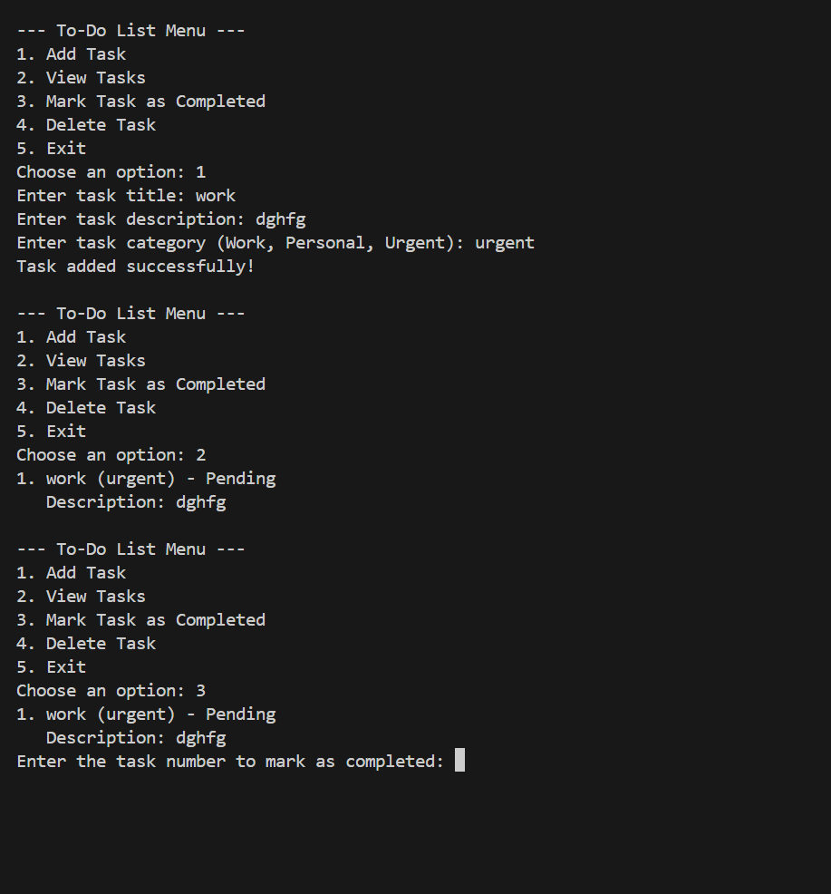
Output:

Slide 12


